Slide 1


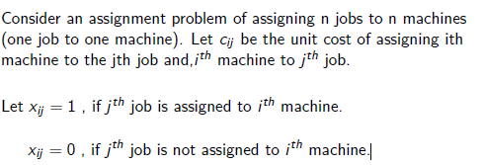
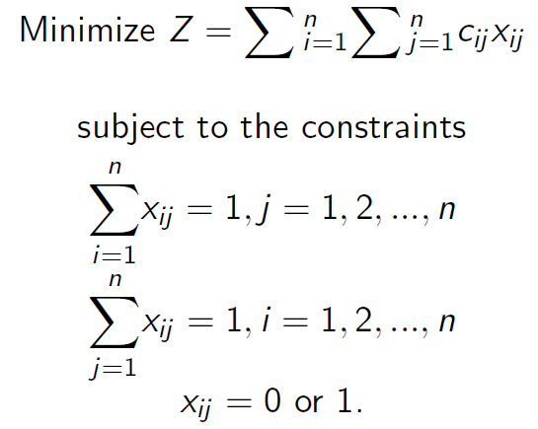
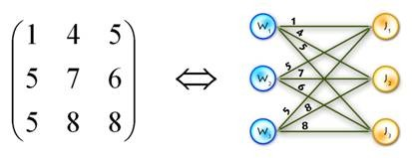

Applications of Matrices in Assignment Problem
K. J. Somaiya College of Engineering, Mumbai – 400 077
(A Constituent College of Somaiya Vidyavihar University) Dept. of Science and Humanities
F.Y. B. Tech. Semester –I (2020-21)
Applied Mathematics-I
IA-I
DEFINATION: An assignment problem is a particular case of transportation problem. The objective is to assign a number of resources to an equal number of activities .So as to minimize total cost or maximize total profit of allocation. The problem of assignment arises because available resources such as men, machines etc. have varying degrees of efficiency for performing different activities, therefore, cost, profit or loss of performing the different activities is different.
AN EXAMPLE OF THE ASSIGNMENT PROBLEM IN TERMS OF A MATRIX:
NAME : ESHAN KALP TRIVEDI
ROLL NO. : 16010221038
DIV: D2
BATCH: ETRX

Slide 2
ASSIGMENT ALGORITHM (OR) HUNGARIAN METHOD:
First check whether the number of rows is equal to number of columns, if it is so, the assignment problem is said to be balanced. Then proceed to step 1. If it is not balanced, then it should be balanced before applying the algorithm.
Step 1: Subtract the smallest cost element of each row from all the elements in the row of the given cost matrix. See that each row contains at least one zero.
Step 2: Subtract the smallest cost element of each column from all the elements in the column of the resulting cost matrix obtained by step 1 and make sure each column contains at least one zero.
Step 3: (Assigning the zeros) (a) Examine the rows successively until a row with exactly one unmarked zero is found. Make an assignment to this single unmarked zero by encircling it. Cross all other zeros in the column of this encircled zero, as these will not be considered for any future assignment. Continue in this way until all the rows have been examined. (b) Examine the columns successively until a column with exactly one unmarked zero is found. Make an assignment to this single unmarked zero by encircling it and cross any other zero in its row. Continue until all the columns have been examined.
Step 4: (Apply Optimal Test) (a) If each row and each column contain exactly one encircled zero, then the current assignment is optimal. (b) If at least one row or column is without an assignment (i.e., if there is at least one row or column is without one encircled zero), then the current assignment is not optimal. Go to step 5. Subtract the smallest cost element of each column from all the elements in the column of the resulting cost matrix obtained by step 1 and make sure each column contains atleast one zero.
Step 5: Cover all the zeros by drawing a minimum number of straight lines as follows: (a) Mark the rows that do not have assignment. (b) Mark the columns (not already marked) that have zeros in marked rows. (c) Mark the rows (not already marked) that have assignments I marked columns. (d) Repeat (b) and (c) until no more marking is required. (e) Draw lines through all unmarked rows and marked columns. If the number of these lines is equal to the order of the matrix then it is an optimum solution otherwise not.
Step 6: Determine the smallest cost element not covered by the straight lines. Subtract this smallest cost element from all the uncovered elements and add this to all those elements which are lying in the intersection of these straight lines and do not change the remaining elements which lie on the straight lines.
Step 7: Repeat steps (1) to (6), until an optimum assignment is obtained.

